Slide 1

Useful Stats for data analysts with data questions
Probability - problems, common misconceptions + conditional probability
Hypothesis forming and testing
Making an inference about a population based on sample data
T tests and P values
Addressing uncertainty - why confidence intervals are useful
Reflection and takeaways

Slide 2
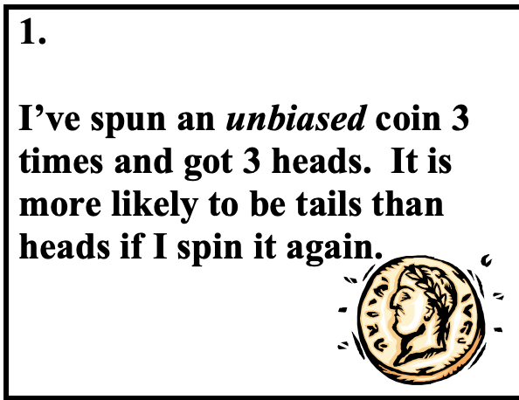
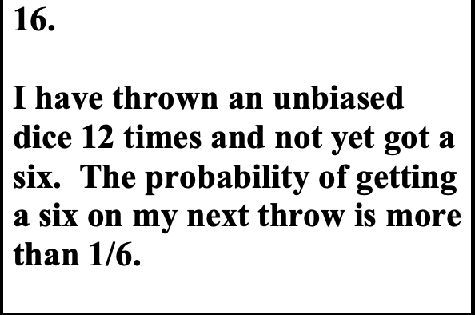
1
Probability problems - True or False?

Slide 3
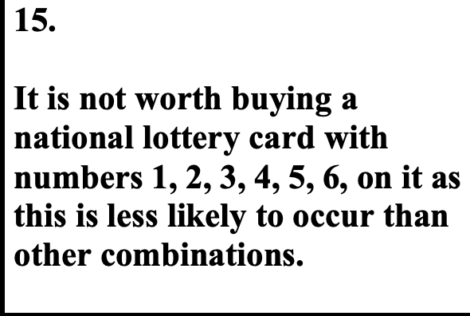
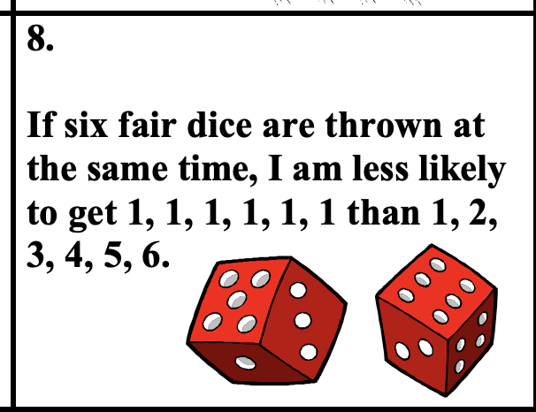
Probability problems - True or False?

Slide 4
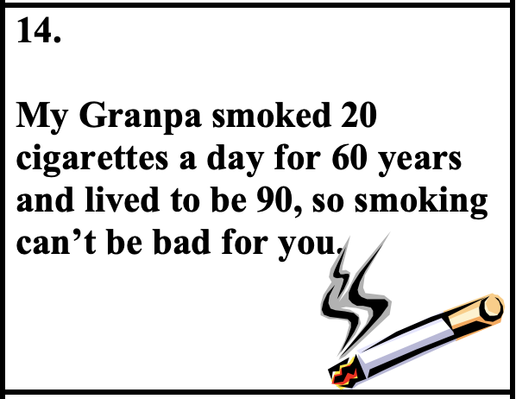
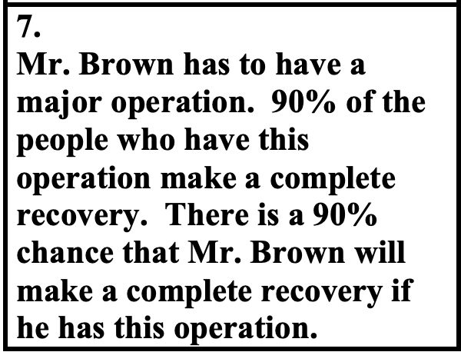
Probability problems - True or False?
Notes:
Misconceptions about probability may include: 1. All events are equally likely 2. Later events may be affected by or compensate for earlier ones 3. When determining probability from statistical data, simple size is irrelevant 4. Results of games of skill are unaffected by the nature of the participants 5. “Lucky/Unlucky” numbers, etc. can influence random events 6. In random events involving selection, results are dependent on numbers rather than ratios 7. If events are random then the results of a series of independent events are equally

Slide 5
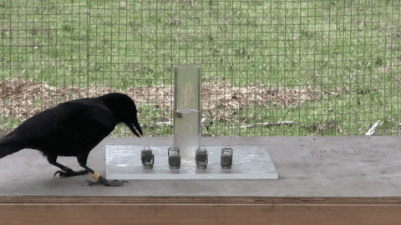
Probability problems - IQ
The average IQ at a specific country is known to be 100. And for the purposes of assessing intelligence at a specific district, we draw a random sample of 50 persons. The first person in our sample happens to have an IQ of 150.
What would you expect the mean IQ to be for the whole sample?

Slide 6

Gambler’s Fallacy
The gambler’s fallacy implies that when we come across a local imbalance, we expect that the future events will smoothen it out. We will act as if every segment of the random sequence must reflect the true proportion and, if the sequence has deviated from the population proportion, we expect the imbalance to soon be corrected.
In fact this is unreasonable – coins, unlike people, have no sense of equality and proportion

Slide 7

Law of small numbers
We intuitively believe that inferences drawn from small sample sizes are highly representative of the populations from which they are drawn.
We have preconceived notions of what randomness looks like.
We also have a tendency to believe in the self-correcting process in a random sample
This generates expectations about sample characteristics and representativeness, which are not necessarily true.
Notes:
The expectation that the patterns and characteristics within a small sample will be representative of the population as a whole is called the law of small numbers.

Slide 8
Conditional Probability problem
When screening for breast cancer, mammography is roughly 90% accurate ( 90% of the women with cancer and 90% of the women without cancer will be correctly classified.
Suppose 1% of women have breast cancer.
How do we work out the probability that a woman who has a positive mammogram test really has breast cancer?

Slide 9
Mammogram
Given that there 10/1000 women have cancer, there's a 8% chance it will be correctly screened with a mammogram
9
True state
positive
10
negative
Hypothetical sample
Not everyone who has cancer goes for a mammogram
Based on estimates - across ? - where is it 90% ?
Under what conditions
Assumes all things being equal
cancer
1
1000 women
No cancer
99
positive
990
negative
891
Notes:
108 positive mammograms. 9 have cancer
9/108- so 8% prob. Not same as 90% accuracy. Prosecutors fallacy

Slide 10
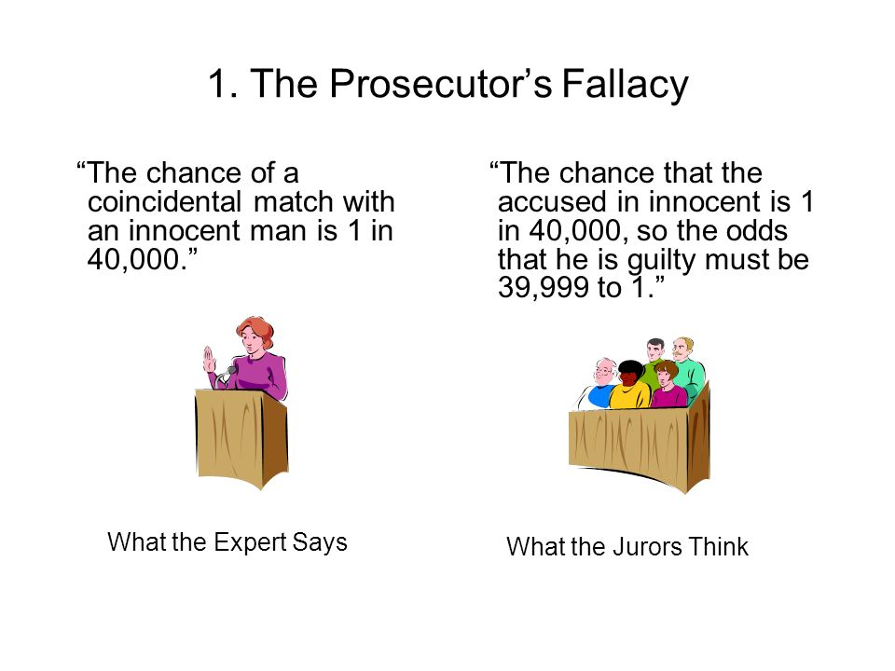
Notes:
108 positive mammograms. 9 have cancer
9/108- so 8% prob. Not same as 90% accuracy. Prosecutors fallacy

Slide 11
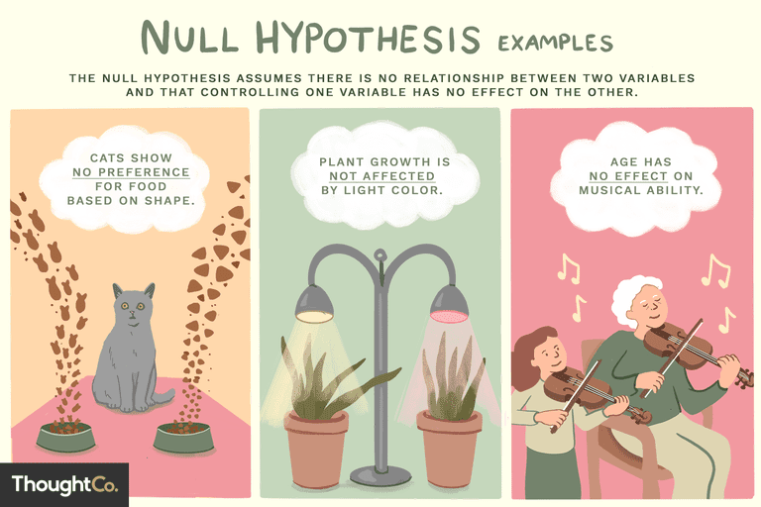
2

Slide 12
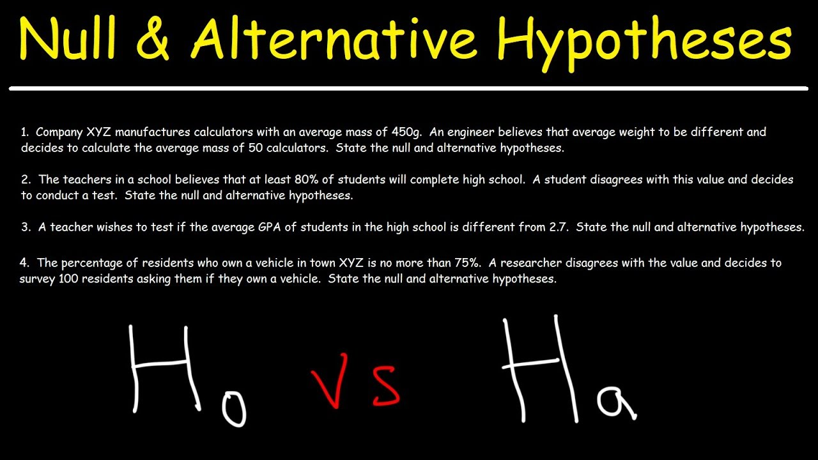

Slide 13
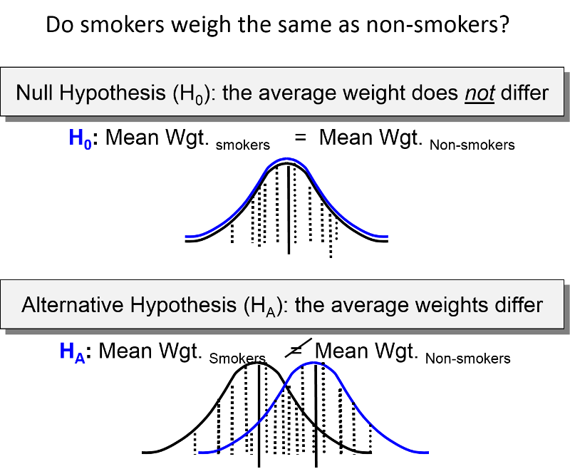

Slide 14


Slide 15
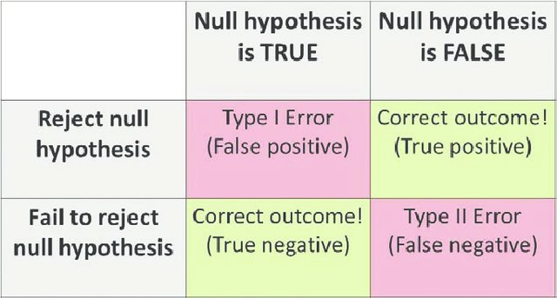
Return of the confusion matrix! woooohoooo!
Notes:
In statistical hypothesis testing, a type I error is the rejection of a true null hypothesis, while a type II error is the non-rejection of a false null hypothesis

Slide 16
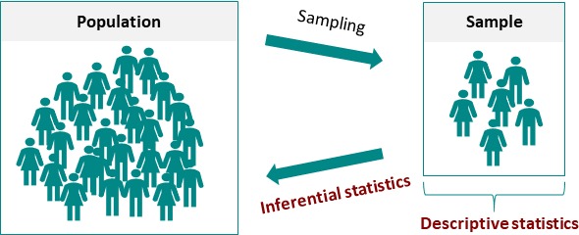
3
Descriptive Statistics = describes / summarizes the data through some statistics which include mean, median, mode, frequency, standard deviation, and variance. In descriptive statistics, there is no uncertainty as we calculate these statistics on the measured values.
Inferential Statistics = helps us to draw inferences about the population, from the given sample data. The goal is to draw conclusions from smaller number of subjects/samples and generalize them on a larger population (where the complete data is unavailable or unknown)
Notes:
Guidance

Slide 17
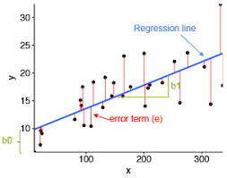
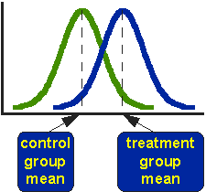
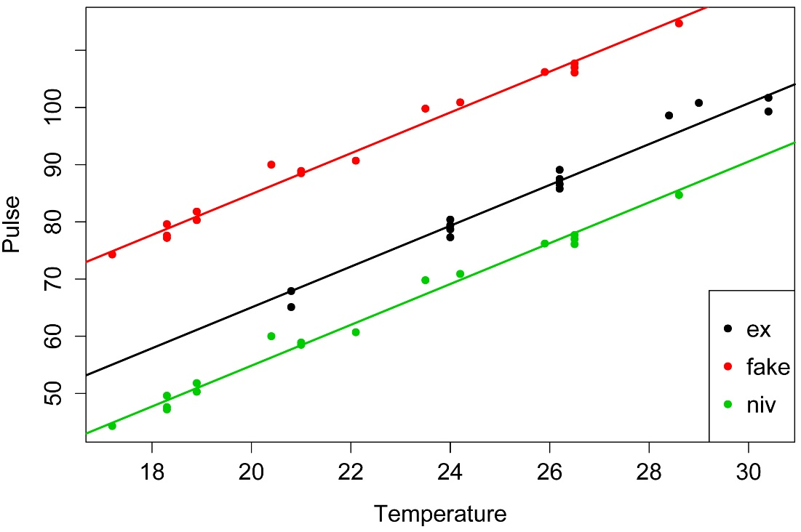
Types of Inferential Statistics - some visual examples
Notes:
Linear regression, , analysis of covariance

Slide 18
2 Tail Test (one sample) hypothesis test
My assumption is that the accepted mean value of a population is incorrect
We only have sample data from the population
Based on this sample data I will try to prove or disprove our assumption
The elements needed to conduct this type of analysis are:
Null hypothesis
Alternate hypothesis
Level of significance
Test statistic
P-value

Slide 19
example scenario
Boys of a certain age are known to have a mean weight of μ = 85 pounds.
A complaint is made that the boys living in a municipal children's home are underfed.
As one bit of evidence, n = 25 boys (of the same age) are weighed and found to have a mean weight of 80.94 pounds.
sample standard deviation is 11.6 pounds.
Based on the available data, how do we know if the complaint is valid?
Notes:
We do not have the complete data.

Slide 20
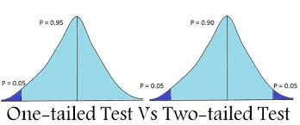
one tail and two tail test
Step1: Define the null hypothesis - H0:
Step 2: Define the alternative hypothesis Ha:
Since in this case, our null hypothesis would be false on either side of Ha, hence such a test is called a two tailed test

Slide 21
Step 1: Define the null hypothesis - This is our assumption about the population. It is defined by H0 and in this case H0: μ = X
Step 2: Define the alternative hypothesis- This means, what if our assumption is not true. It is defined by Ha and in this case Ha: μ != X
Since our null hypothesis would be false on either side of Ha, hence such a test is called a Two tailed Test, ie if Ha: μ > X and if Ha: μ < X, in both cases, H0 is false
Step 3: Calculate test statistics based on the information available.
Assuming data is normally distributed and the number of observations are small, that the data is continuous and we are focused on the mean difference, we can use a t-test. This test is based on a "student’s t distribution" which is very similar to standard normal distribution, except it is much flatter on tails.
Notes:
https://www.statisticshowto.com/tables/t-distribution-table/
https://statisticsbyjim.com/hypothesis-testing/t-tests-t-values-t-distributions-probabilities/

Slide 22
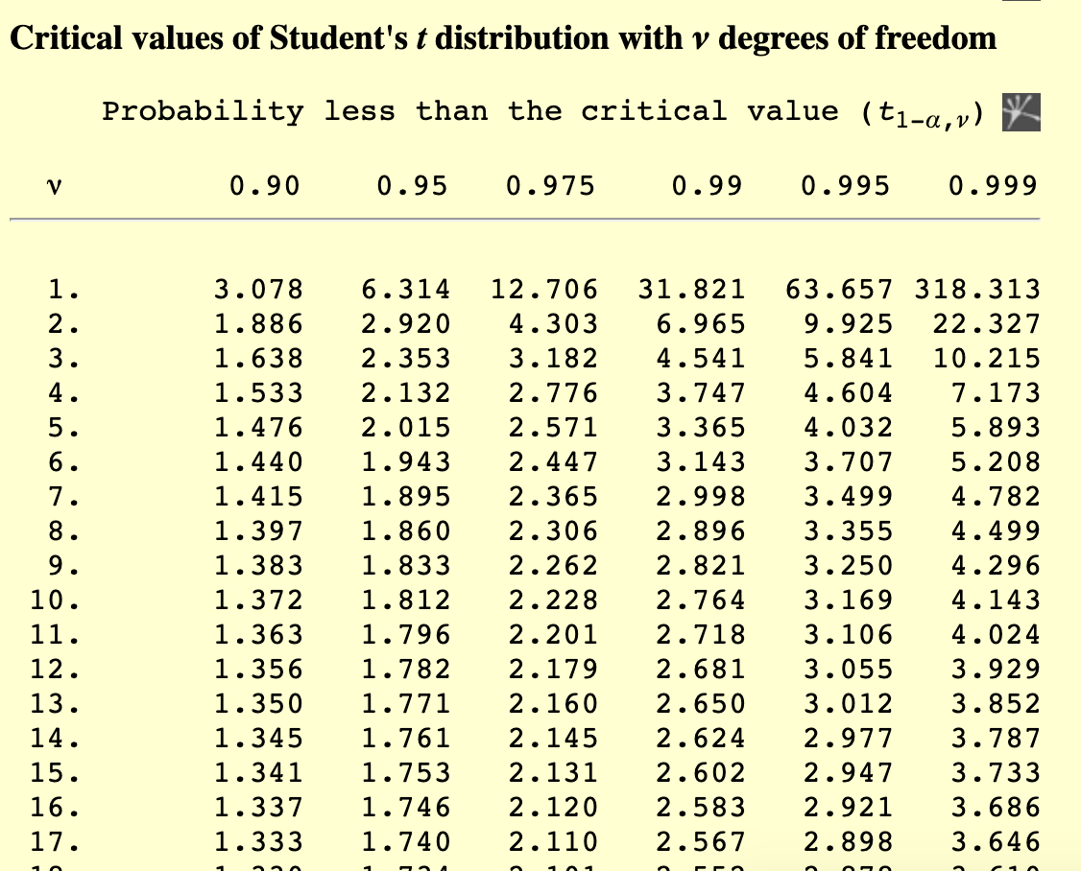
T test value
Degrees of Freedom refers to the maximum number of logically independent values, which are values that have the freedom to vary, in the data sample. Degrees of Freedom are commonly discussed in relation to various forms of hypothesis testing in statistics

Slide 23
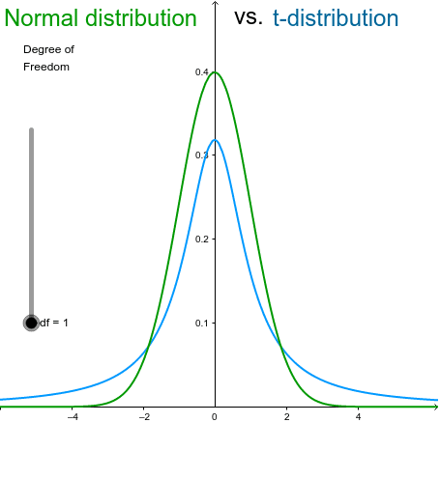
What’s the key difference between the t- and z-distributions?
The standard normal or z-distribution assumes that you know the population standard deviation.
The t-distribution (known as the student’s t-distribution) is based on the sample standard deviation.
NB - the shape changes with df
Notes:
Typically, the degrees of freedom equal your sample size minus the number of parameters you need to calculate during an analysis. It is usually a positive whole number. Degrees of freedom is a combination of how much data you have and how many parameters you need to estimate.
T tables

Slide 24
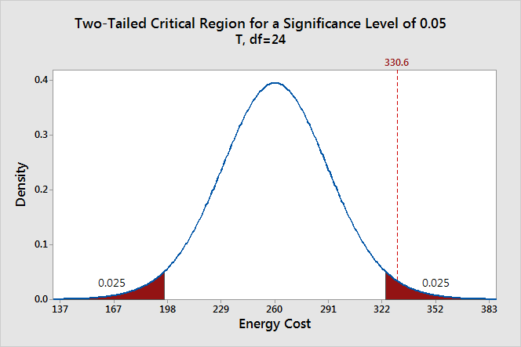
Step 4: Level of significance: This defines the rejection region - the probability of rejecting H0 if it were true. It is denoted by alpha or α, conventionally 0.05 or 0.01
Step 5: Calculate the test statistic based on the sample data:
If the test statistic falls in the critical region-> reject H0
If the test statistic falls outside the critical region, then we cannot reject H0
This does not mean H0 is true
To graph a significance level of 0.05, we need to shade the 5% of the distribution that is furthest away from the null hypothesis.

Slide 25
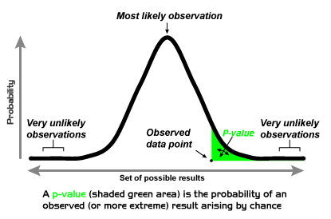
HYPOTHESIS TESTING - p-value
p value is another method for rejecting H0
We can use it to verify the test statistic result
We can derive the p-value from the t-table
p-value is a measure of discrepancy between observed results and H0
Were H0 true, what's the probability of observing at least as extreme value?
p-value is used as a direct measure of statistical significance
Conventionally the threshold is 0.05

Slide 26
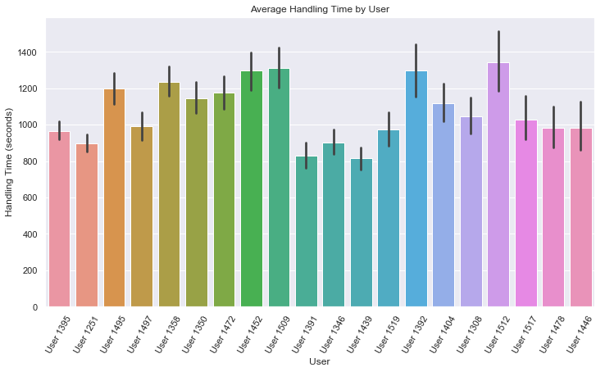
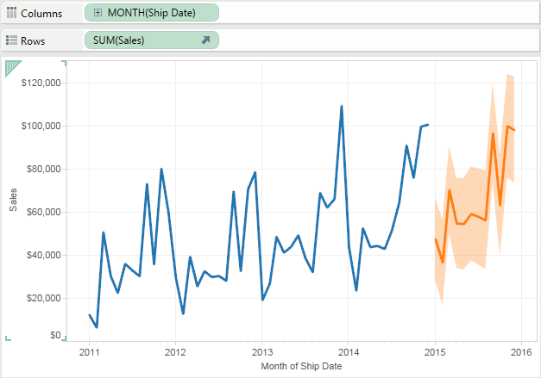
4
Dealing with Uncertainty
For any given research question, are you easily able to define the population?
What methods can be undertaken to collect data which accurately reflects the target population?
Margin of error should be reflected in reported results
Display charts with confidence interval (normally 95%)
(Does not include systematic error)
Notes:
https://www.mathsisfun.com/data/confidence-interval-calculator.html
https://www.theinformationlab.co.uk/2019/10/25/standard-errors-and-confidence-intervals-in-tableau/
https://www.surveymonkey.co.uk/mp/margin-of-error-calculator/

Slide 27
What is a confidence interval
A confidence interval is a range of values that encloses a parameter with a given likelihood.
So let's say we've a sample of 200 people from a population of 100,000. Our sample data come up with a correlation of 0.41 and indicate that the 95% confidence interval for this correlation runs from 0.29 to 0.52.
This means :
the range of values -0.29 through 0.52
has a 95% likelihood of enclosing the parameter (the correlation for the entire population) that we'd like to know.
So basically, a confidence interval tells us how much our sample correlation is likely to differ from the population correlation we're after.
Notes:
https://www.mathsisfun.com/data/confidence-interval-calculator.html
https://www.theinformationlab.co.uk/2019/10/25/standard-errors-and-confidence-intervals-in-tableau/
https://www.surveymonkey.co.uk/mp/margin-of-error-calculator/

Slide 28
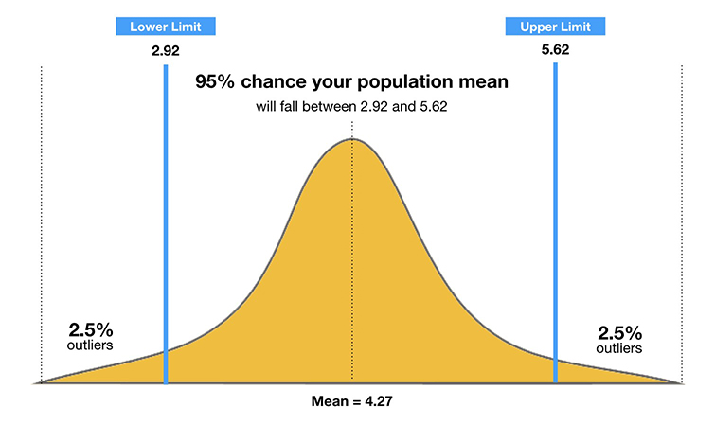
Visualising a confidence interval
Notes:
https://www.mathsisfun.com/data/confidence-interval-calculator.html
https://www.theinformationlab.co.uk/2019/10/25/standard-errors-and-confidence-intervals-in-tableau/
https://www.surveymonkey.co.uk/mp/margin-of-error-calculator/

Slide 29
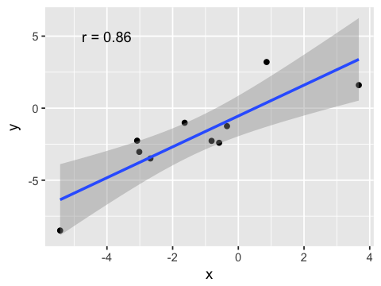
Visualising a confidence interval

Slide 30
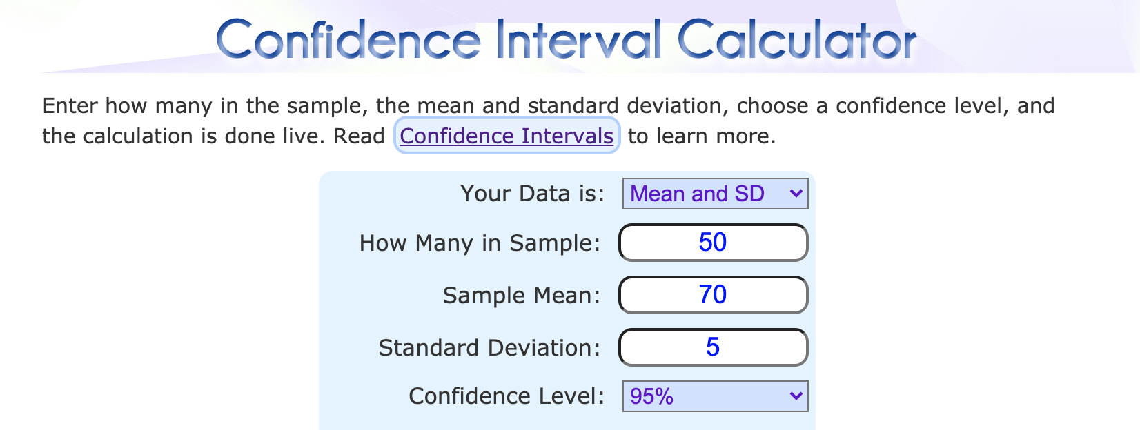
Calculate the confidence interval
Notes:
https://www.mathsisfun.com/data/confidence-interval-calculator.html
https://www.theinformationlab.co.uk/2019/10/25/standard-errors-and-confidence-intervals-in-tableau/
https://www.surveymonkey.co.uk/mp/margin-of-error-calculator/

Slide 31
5
How do we apply these principles?
1 - Propose an explanation for a phenomenon
- this is the working assumption, not the absolute truth
remember - We all have an innate need to ‘discover’ things
2 - Assume null until proven otherwise - through experimentation, analysis and method-critical review- eg t test
3 - Think about how much variation is natural in the population, include a confidence interval
4 - Consider systematic bias, or that observations are not independent

